Slide 1

Principles of visual design

Slide 2
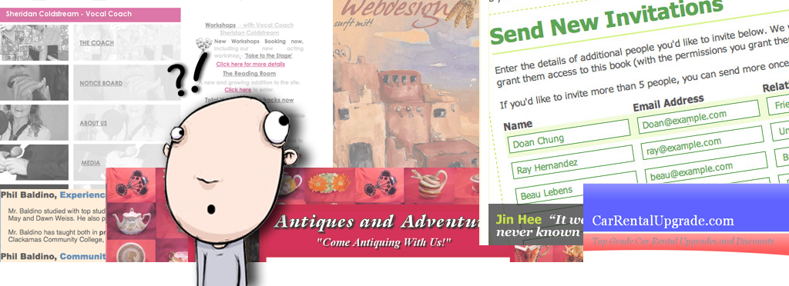
Use of principles of visual Design
Confused user?
2

Slide 3

Use of principles of visual Design
Why?
Users have a purpose to visit a websites, it could be
To procure information
To perform a task
Web page
Goal
procure information
perform a task
A website is not successful in achieving its goal when the user is unable to perform the desired task.
3

Slide 4

Use of principles of visual Design
How can we tackle this?
Understanding the user makes the task of designing a user-friendly web page or application easier.
Insight into the cognitive abilities in terms of working with computers
Memory & perception.
Attention
Learning
User friendliness in visual design can be achieved by applying the Principles of Design.
4

Slide 5
Principles of Design
The principles govern the relationships of the elements used and organize the composition as a whole.
Balance
Proportion
Emphasis
Rhythm
Unity
5
Use of principles of visual Design
5

Slide 6
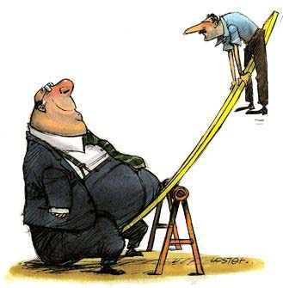
Balance
Use of principles of visual Design
Balance is the concept of visual equilibrium, and relates to our physical sense of balance.
It results in visual stability.
Types of balance:
Symmetrical
Asymmetrical
6

Slide 7
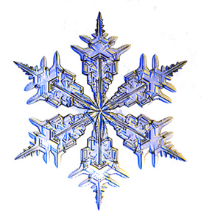
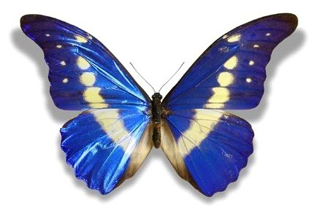
Symmetrical Balance
Use of principles of visual Design
Symmetrical balance is achieved by placing elements in a very even fashion across a central axis.
Radial Symmetry
Bilateral Symmetry
7

Slide 8
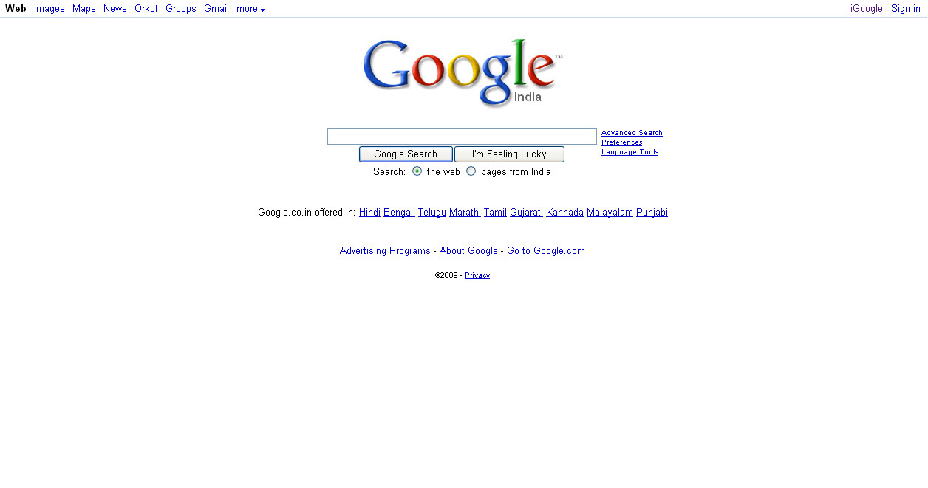
Use of principles of visual Design
Centering is the easiest way to get a symmetrically balanced page.
8

Slide 9
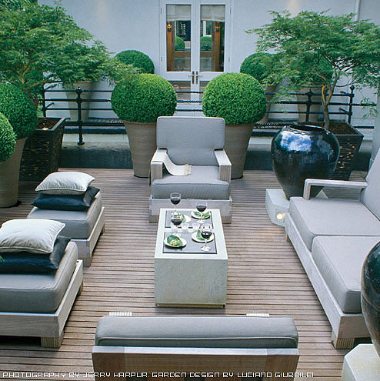
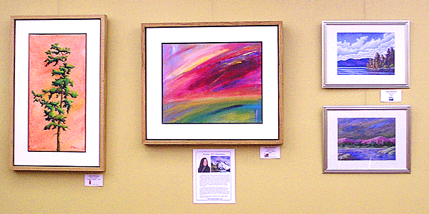
Asymmetrical Balance
Use of principles of visual Design
It involves placement of objects in a way that will allow objects of varying visual weight to balance one another around a fulcrum point.

Slide 10
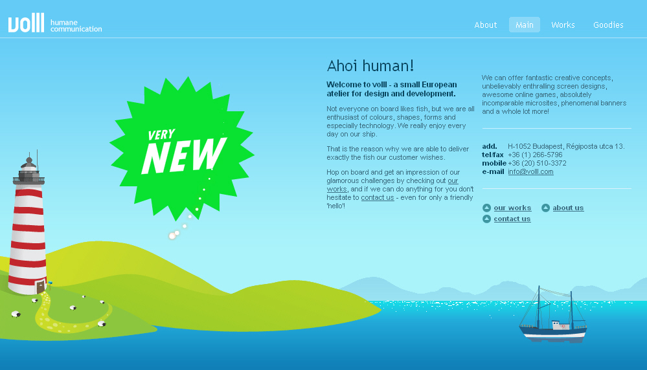
Use of principles of visual Design
10

Slide 11
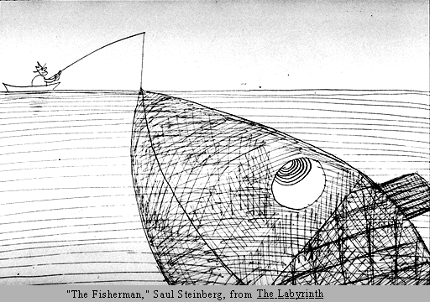
Use of principles of visual Design
Proportion
Proportion is the relationship of visual elements in a design, one to another and to the whole.
Relation in terms of of size, shape, color and quantity.
Proportion can cause contrast.
11

Slide 12
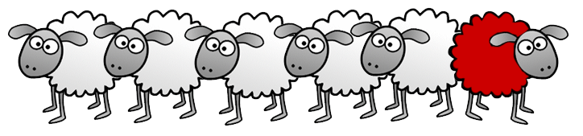
Emphasis
Use of principles of visual Design
Emphasis
In order to invite some order to the chaos, you need to assign a hierarchy to the elements in the design.
The hierarchy tells the customer how the page is meant to be viewed.
Techniques for Providing Emphasis
Size
Colors
Spacing
Location
Whitespace
Contrast
?
12

Slide 13
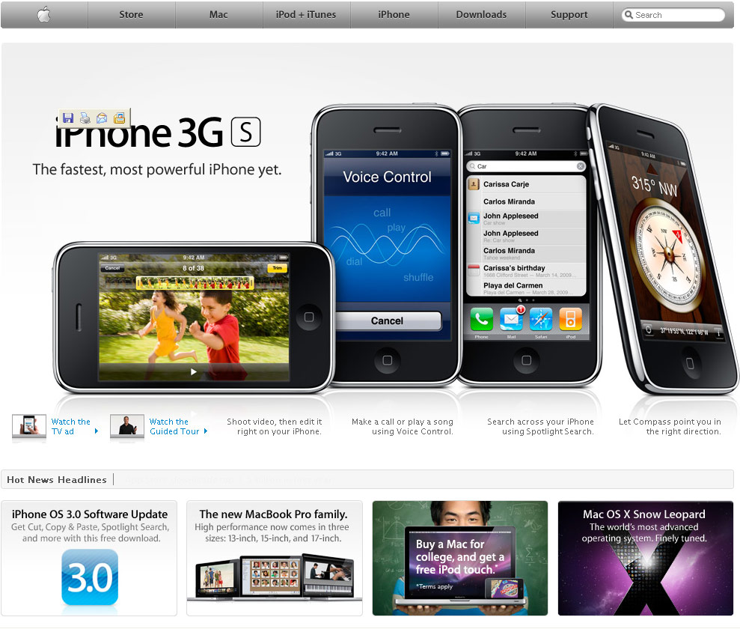
Use of principles of visual Design
13

Slide 14

Use of principles of visual Design
Rhythm
It helps to associate elements by repeating a common stylistic feature or arrangement.
How to Achieve Rhythm:
Repeat a headline
Color
Image
Repeat a style throughout the pages of your site to provide consistency.
14

Slide 15
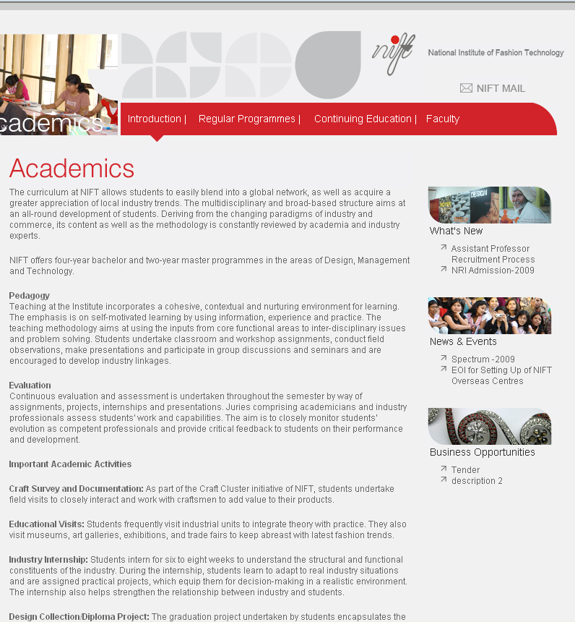
Use of principles of visual Design
15

Slide 16
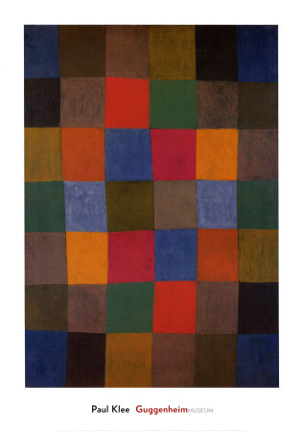
Harmony
Use of principles of visual Design
Harmony
It brings together a composition with similar units.
If your composition was using wavy lines and organic shapes you would stay with those types of lines and not put in just one geometric shape.
Harmony can be achieved by:
Similar fonts
Similar colors
Pictures which match the topic
Graphics which are similar in tone
16

Slide 17
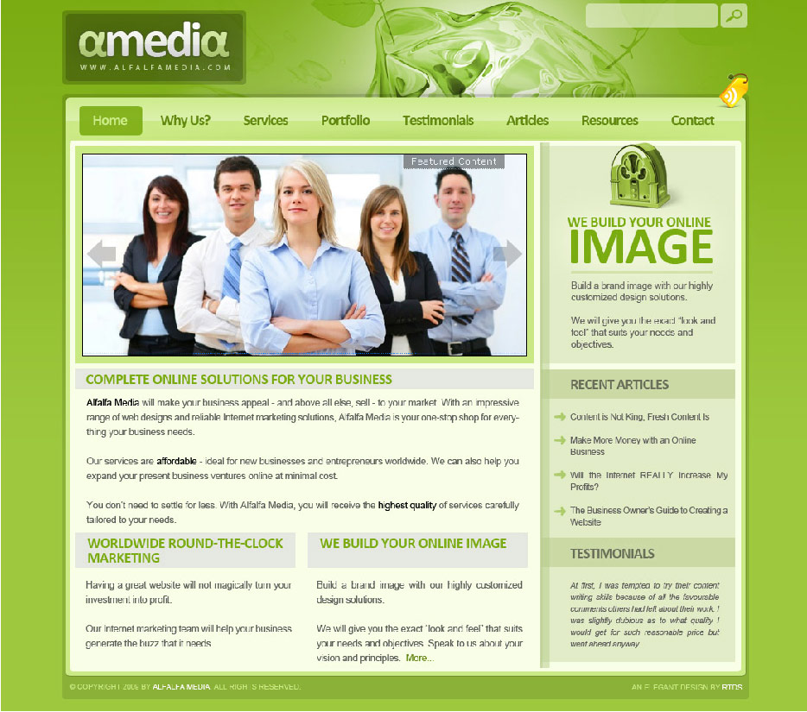
Use of principles of visual Design
17

Slide 18
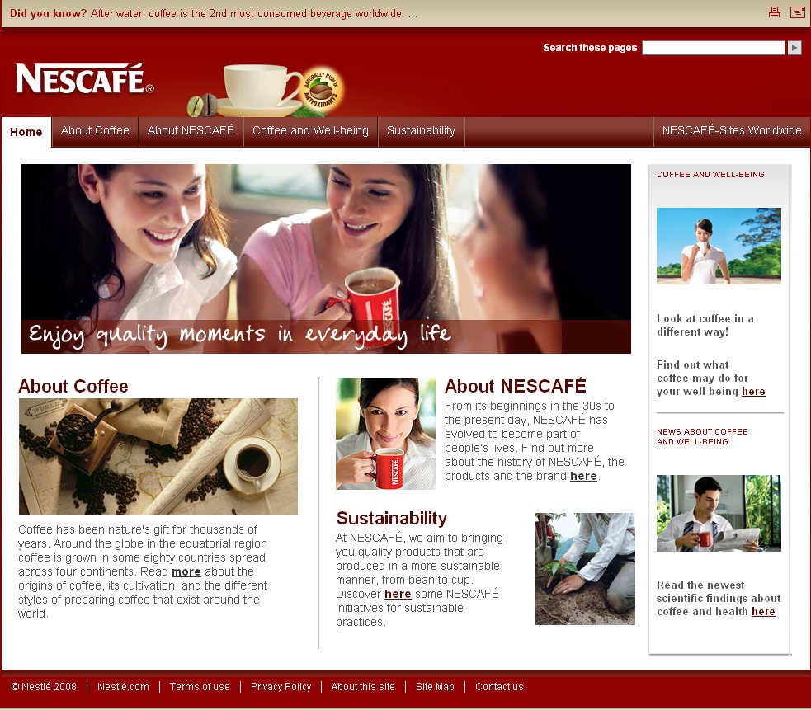
Use of principles of visual Design
18

Slide 19
Use of principles of visual Design
Balance
Proportion
Emphasis
Rhythm
Harmony
19

Slide 20

Thank You
20
20

